Slide 1
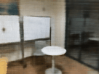
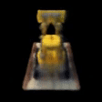
3D scene reconstruction from images
蒋炘宏 谭世涛

Slide 2
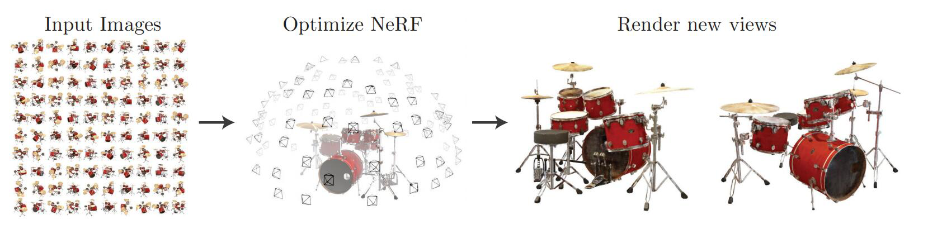
Background

Slide 3
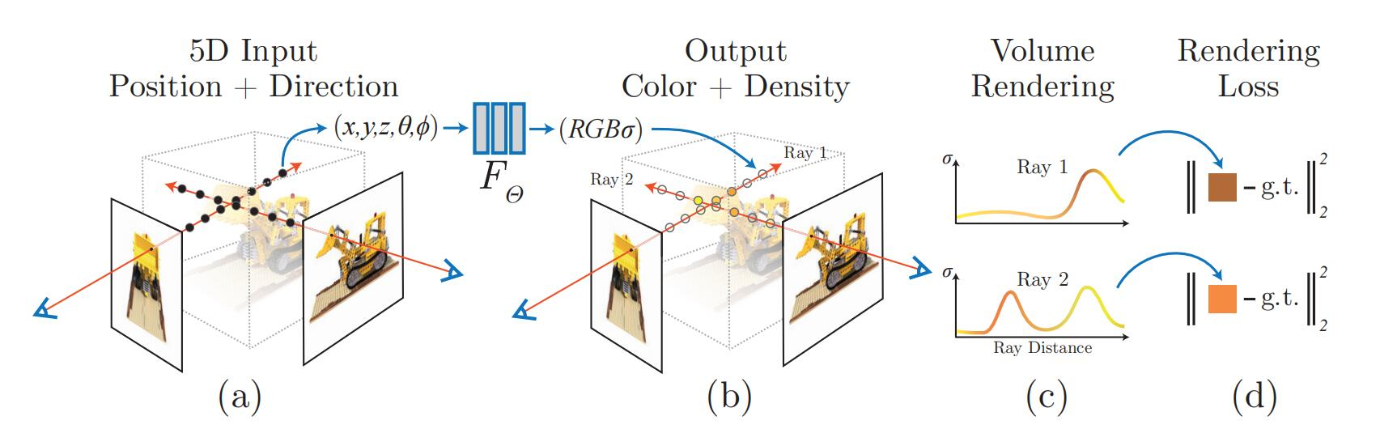
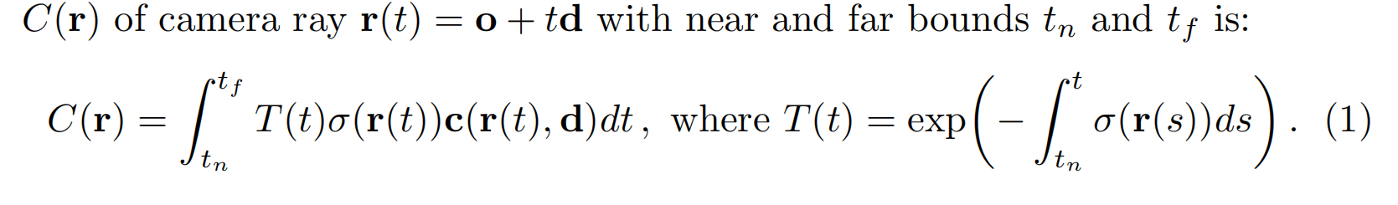
Principle

Slide 4
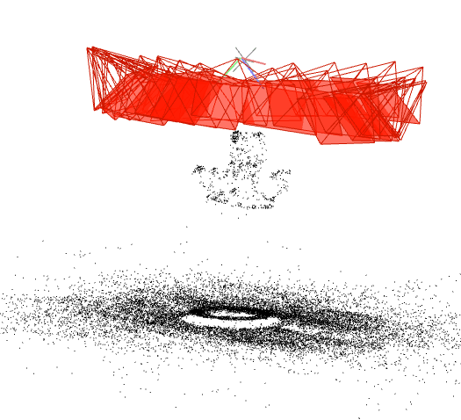
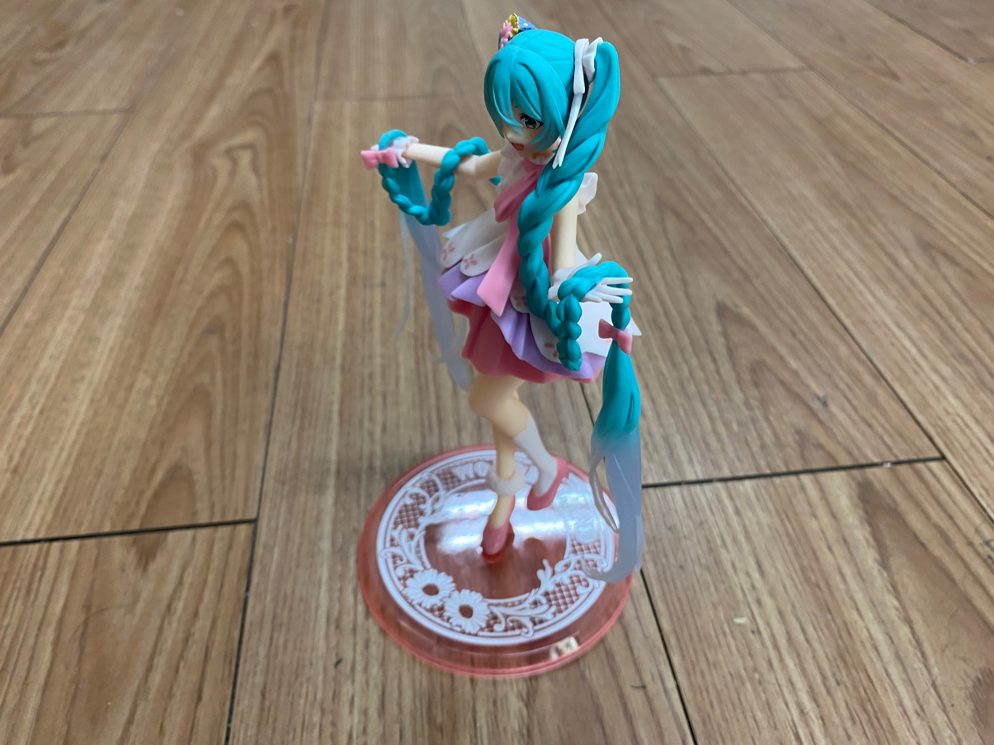
Reconstruction
colmap
sparse reconstruction
Bounding poses

Slide 5
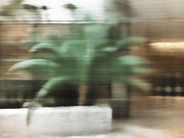

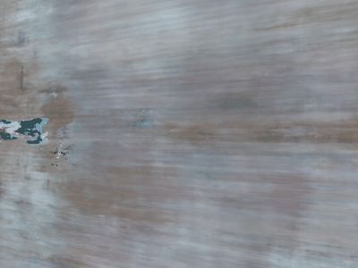
Effect
Dataset quality
Background
continuity
Image size
360 degree scene works not easy
1000 iteration
20K iteration loss=0.005, train_psnr=27.4

Slide 6
Argument
Forward Facing scene √
360 inward-facing scene
Dataset quality
Background
continuity
1000 iteration

Slide 7
Thanks

